Slide 1
Blinkit Sales Performance Analysis
To evaluate total sales, consumer preferences for fat content, and outlet performance across different tiers and item types.
Key Performance Indicators (KPIs):
Total Sales: $1.20M.
Average Sales: $141.
Number of Items: 8,523.
Average Rating: 3.9.

Slide 2
Data Cleaning & Transformation
Item Standardization: Ensuring "Item Type" categories like "Fruits and Vegetables" and "Snack Foods" are consistent for accurate aggregation.
Fat Content Normalization: Categorizing products strictly into "Low Fat" or "Regular" to streamline analysis.
Outlet Categorization: Organizing locations into Tier 1, Tier 2, and Tier 3 for geographical performance tracking.

Slide 3
Descriptive Statistical Analysis
Fat Content Distribution: Low Fat items account for approximately 64.7% ($776.32K) of total sales, while Regular items account for roughly 35.3% ($425.36K).
Sales by Location:
Tier 3: The highest-earning tier with $0.48M in combined sales.
Tier 2: $0.39M in combined sales.
Tier 1: $0.34M in combined sales.

Slide 4
DAX Calculations & Measures
Total Revenue Measure: A sum of sales across all item types and outlets, totaling $1.20M.
Fat Content Comparison: Calculations showing Low Fat sales ($776.32K) versus Regular Fat sales ($425.36K).
Outlet Type Performance: Metrics tracking sales and item counts across Supermarket Type 1, Type 2, Type 3, and Grocery Stores.

Slide 5
Data Visualizations & Dashboard Design
Doughnut Chart: Used to visualize the proportion of Total Sales by Fat Content.
Bar Charts:
Item Type: Ranking sales from highest (Fruits/Snacks at $0.18M) to lowest (Seafood at $0.01M).
Fat by Outlet: Segmented bar charts showing the breakdown of Low Fat vs. Regular sales across three tiers.
Outlet Type Performance: Metrics tracking sales and item counts across Supermarket Type 1, Type 2, Type 3, and Grocery Stores.
Grid Analysis: A detailed table at the bottom comparing Outlet Type by Total Sales, No. of Items, Avg Sales, and Avg Rating.

Slide 6
Insights & Analysis
Consumer Trend: There is a clear preference for Low Fat products across all outlet tiers.
Top Categories: Fruits and Vegetables and Snack Foods are the primary revenue drivers, each contributing $0.18M.
Outlet Efficiency: Supermarket Type 1 is the most significant contributor to volume, handling 5,577 items and generating $787.55K.
Geographic Focus: Tier 3 locations are currently the most profitable market segment.

Slide 7
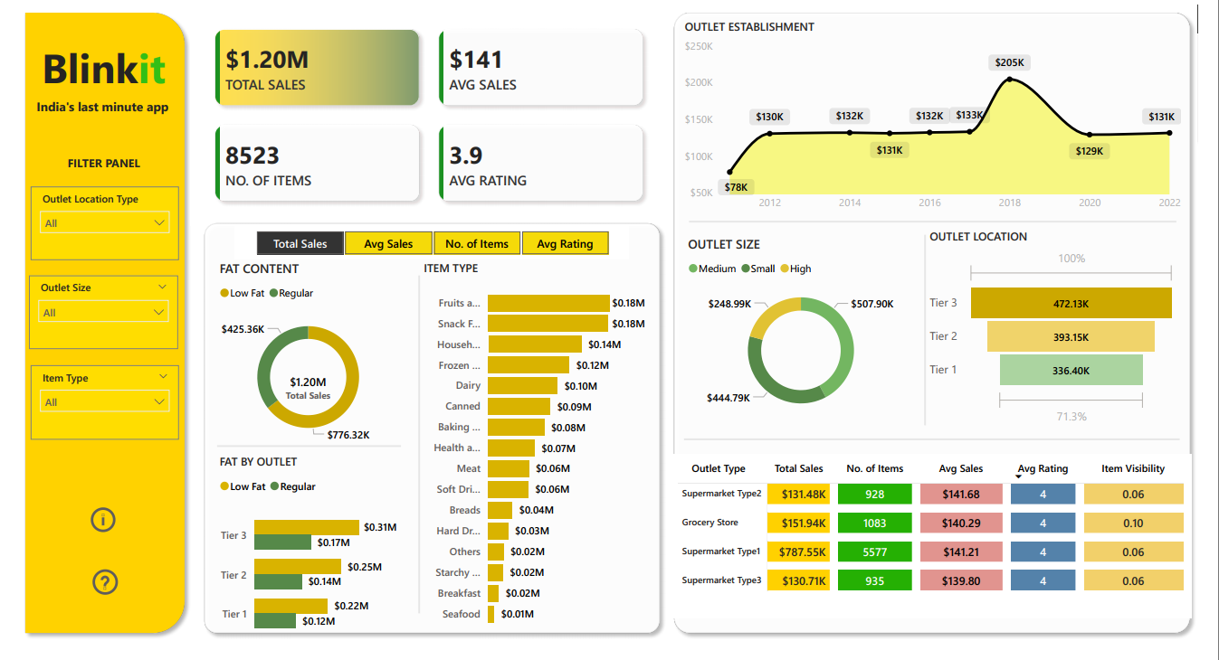
Dashboard Overview

